Slide 1
UF QEP Assessment Orientation
August 27 & 28, 2024
Office of Institutional Assessment
Lissette Tolentino, Associate Director and Assistant Scholar
Mackenzie Donovan, Project Manager AI2 Center
Guest:
CITT and COIP
Notes:
Lissette
Hello everyone and welcome esteemed faculty members!
Thank you for joining us today for the Quality Enhancement Plan (QEP) assessment orientation. As educators dedicated to fostering academic excellence and student success, your role in the QEP is crucial and pivotal. This orientation aims to provide you with a comprehensive understanding of the QEP assessment process, its significance, and how you can contribute to its successful implementation.
I’m Lissette Tolentino, Associate Director and Assistant Scholar in the Office of Institutional Assessment located in the Provost’s office and I am excited to be a part of this process with you all.
Next, I’ll let Mackenzie introduce herself.
Alright, and now I am going to ask if the instructional designers can introduce themselves

Slide 2


Overview of Today’s Meeting
1
QEP Brief Overview
2
QEP Assessment
AI ACROSS THE CURRICULUM
3
Questions
Notes:
Lissette
Here is our overview for today.
First we will provide a brief overview of the QEP
Second, we will go over and provide details of the QEP Assessment process and we will have our instructional designers present a few things on the process
Third, we will wrap up and give you a chance to ask any questions or comments

Slide 3
QEP Brief Overview
What is the Quality Enhancement Plan (QEP): AI Across the Curriculum?
Comprehensive, Institution-Wide Project
  Inclusive of all students
  Integrates initiatives with Graduate School, professional colleges, and relevant institutes and centers
AI Across the Curriculum
  Extends AI concepts, skills and applications to all students
3
Notes:
*Mackenzie*
Next up, we will provide a brief overview of what QEP is
UF underwent its reaffirmation of accreditation with SACSCOC (our accreditor) this past February.
For each decennial reaffirmation, SACSCOC requires that institutions prepare and present a five-year Quality Enhancement Plan (QEP)
UF’s 2024-2029 QEP is a comprehensive institution wide project that is inclusive of all students and integrates initiatives in the Grad School, professional colleges, and relevant institutes and centers with AI and UF Quest
To this end, the QEP aims to integrate these initiatives to the entire UF student body through UF quest and aforementioned initiatives taking place in other areas of our institution

Slide 4
Quality Enhancement Plan: AI Across the Curriculum
QEP Brief Overview
Why AI Across the Curriculum?
Topic Development:
Campus-wide effort initiated at the Office of the Provost
QEP Task Force is Formed
Two faculty members Co-Chairs (Dr. Kati Migliaccio and Dr. Jane Southworth)
Representation (Faculty, administrators, staff, and students)
18 months – development of the QEP
Dissemination across UF Campus
AI Across the Curriculum is designed to:
Provide students with the resources and skills to become:
          digital citizens
          global collaborators
Support students’ acquisition of:
basic awareness
general knowledge of AI
Allow opportunities for students to:
  apply and use AI in relevant, discipline-specific ways
  develop foundational expertise in AI
Notes:
*Mackenzie*
Why AI Across the Curriculum?
AI Across the Curriculum is designed to provide students with the resources and skills to become successful digital citizens and global collaborators (Zimmerman, 2018), acquire basic awareness and general knowledge of AI, have the opportunity to apply and use AI in relevant, discipline-specific ways, and develop foundational expertise in AI.
Topic Development:
We developed our topic through a thoughtful, inclusive, campus-wide process initiated by the provost.
QEP Task Force is formed
Two faculty members were assigned as QEP co-chairs
Institutionally representative Task Force of faculty, staff, students, and administrators was convened in September 2021 and charged to develop a five-year plan (2024- 2029)
Task Force met for 18 months to develop and refine the initiatives that would operationalize the project across the institution.
Dissemination across campus constituents.

Slide 5
Quality Enhancement Plan: AI Across the Curriculum
QEP Brief Overview
QEP Student Learning Outcomes
AI Literacies (Ng et al. (2021):
AI LITERACY CATEGORIES | DESCRIPTION | AI CONTENT
Know & Understand AI | Know the basic functions of AI and to use AI applications | >50%
Use & Apply AI | Applying AI knowledge, concepts and applications in different scenarios | >50%
AI Ethics | Human-centered considerations (e.g., fairness, accountability, transparency, ethics, safety) | >50%
Evaluate and Create AI | Higher-order thinking skills (e.g., evaluate, appraise, predict, design) with AI applications | >50%
AI Enabled | Support AI through related knowledge and skill development (e.g., programming, statistics) and/or contain a lower total AI content of one of the four Core AI Literacy topics. | 10-49%
Six SLOs across four artificial intelligence literacies Ng et al. (2021).
Assessment of outcomes integrated with UF’s annual assessment system:
Reporting
Evaluation
Use of results for improvement
Notes:
*Mackenzie*
QEP SLOS:
The QEP Task Force developed six SLOs grounded in the four artificial intelligence literacies defined by Ng et al. (2021). The assessment of these outcomes intentionally integrates into UF’s existing annual assessment and institutional effectiveness system for reporting, evaluation, and use of results for improvement
AI Literacies:
The AI² Center and the QEP Task Force co-hosted a workshop on May 9, 2022, to consider the process of linking existing and future AI courses to the following AI literacy topics, as outlined by Ng et al. (2021):
Know & Understand AI
Use & Apply AI
Evaluate & Create AI
AI Ethics
The four core AI literacy topics are used to categorize the type of knowledge and skills students are gaining through learning experiences. A fifth category, “AI Enabled”, was also identified to capture academic courses that support AI through related knowledge and skill development and/or contain a lower total AI content of one of the four core AI literacy topics.

Slide 6
Quality Enhancement Plan: AI Across the Curriculum
QEP Brief Overview
QEP Student Learning Outcomes
SLO
SLO1. Identify, describe, and/or explain the components, requirements, and/or characteristics of AI.
SLO2. Identify, describe, define and/or explain applications of AI in multiple domains.
SLO3. Select and/or utilize AI tools and techniques appropriate to a specific context and application.
SLO4. Develop, apply, and/or evaluate contextually appropriate ethical frameworks to use across all aspects of AI.
SLO5. Assess the context-specific value or quality of AI tools and applications.
SLO6. Conceptualize and/or develop tools, hardware, data, and/or algorithms utilized in AI solutions.
Notes:
*Mackenzie*
The Task Force and the Assessment Subcommittee identified QEP SLOs for the AI literacy topics proposed.

Slide 7
QEP Assessment
Why and How we assess the QEP Goals and SLOs
Why:
Institutional Assessment and Effectiveness System
Evaluation Processes
QEP Goals and SLO Assessment
How:
QEP Goals and outputs focus on curricular activities
SLOs are assessed via a rubric associated with key assessments
7
Notes:
*Lissette*
Why and How we assess the QEP Goals and SLOs?
Why:
The University of Florida’s Institutional Assessment and Effectiveness System involves all academic programs, administrative units, and initiatives in continuous, integrated evaluations. These evaluations focus on institutional quality and effectiveness by systematically assessing goals and outcomes to support the university’s mission. The QEP goals and SLOs assessments are integrated into this system, generating annual reports with data for analysis and improvement.
The University of Florida’s Institutional Assessment and Effectiveness System engages all campus academic programs, administrative units, and institution-wide initiatives in ongoing and integrated institution-wide evaluation processes that focus on institutional quality and effectiveness through the systematic evaluation of institutional goals and outcomes to advance the university's mission. The assessment of the QEP goals and SLOs has been intentionally designed to integrate into our existing system in order to generate annual impact evaluation reports that provide substantial data for analysis and review by relevant campus constituencies and to facilitate the use of these data for improvement.
How:
The QEP goals and outputs focus on the curricular activities (e.g., courses and academic programs) as well as other AI learning opportunities such as AI research and internships.
The QEP SLOs are assessed via rubric associated with key assessments in Canvas. This presentation is centered on the assessment of SLOs.

Slide 8
The Six SLO Rubrics
QEP Assessment
Rubric Design
Achievement Levels
Holistic rubric
allows autonomy in rating
accommodates discipline-specific skills
provides actionable data for institutional review and use for improvement
Four achievement levels
  (3) is the Target.
  (4) exceeds the Target
  (2) or (1) below the Target
Notes:
*Lissette*
Due to the multifaceted nature and variability of AI applications within various disciplines across the university, the assessment sub-committee members agreed to develop a four-scale, holistic rubric for each SLO.
In this rubric, each SLO is measured using four broadly described achievement levels.
This allows faculty sufficient autonomy in rating, accommodates the variety of applications and discipline-specific skills in UF’s over 200 unique programs, and provides actionable data for institutional review and use for improvement.
The six rubrics define the performance indicators established for each SLO. Each rubric is based on a four-point scale where three (3) is the Target.
A score of four (4) shows performance that exceeds the Target, and scores of two (2) or one (1) are below the Target.

Slide 9
The Six SLO Rubrics
QEP Assessment
Notes:
*Lissette*
These are the rubrics that you will be using.
Each one is unique for each SLO, and as a you can see it is a reflection of the SLO at different criteria levels.

Slide 10
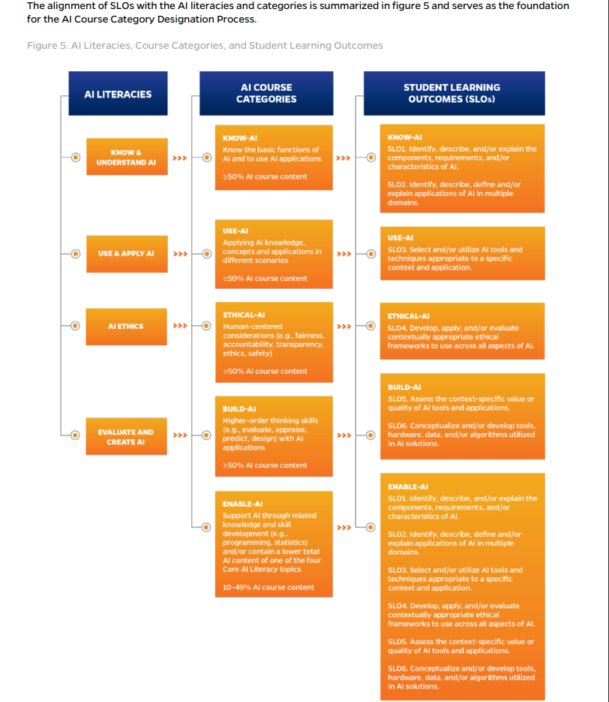
*Note: You can find more details in the QEP AI Assessment Guide and Rubrics document
Notes:
Where do the SLOs come from?
Depending on the AI course category designation a course receives, it aligns with a particular SLO.
For example, if your course is designated as an “ethical-AI” course, then you would be assessing for SLO 4.
If your course is “enable-AI”, then you would be assessing for either all, or some of the SLOs.
What you need to remember is that the assignment needs to be in alignment to the rubric. Additionally, if you do have more than one SLO, and you want to use one assignment, you need to ensure that the assignment covers both SLOs.

Slide 11
Process
QEP Assessment
Three-Step Process:
Important!
Sampling
Random selection: 20% sample (AI designated courses)
Assignment Selection
Faculty identify course assignment(s) to measure AI SLOs
IDs assist faculty associating rubrics with assignments
Rating Criteria
Criteria are assessed at the same time the assignment is graded
The 20% sample will be provided for each faculty member via e-mail (Password protected file)
Faculty choose course assignment and schedule appointment with instructional designers (IDs) to set up the rubrics (Use link: Booking for Outcome Setup)
AI SLO rubrics:
Must be scored using Speed Grader, otherwise data will not be recorded. This is a crucial step!
Do not interfere with students’ grades (IDs set up)
Notes:
Depending on the designation they receive, they may have multiple SLOs. SLO 1-4 is listed as is, if it is an “enabled” category you can pick between 1-6 SLOs, you should chose the one that is in alignment to the assignment(s)
Data Collection (Fall & Spring) – Each year—Fall and Spring Terms
This is the process for data collection, which will happen each year in the fall and spring terms.
This is our first year rolling out this process for the AI QEP, but it is a mirror to the Quest assessment process
First,
Sampling:
a. AI2 Center provides a list of AI Designated Courses including the following information:
i. Course name and section number
ii. Instructor name and e-mail address
iii. Delivery mode and/or location (i.e., Online or Residential; On-Campus or Off-Campus)
b. Then, the Office of Institutional Planning and Research (OIPR) receives this list and determine a random sample of 20% students for each section.
This should be completed after drop/add period each fall and spring. This sample file is shared with the Office of Institutional Assessment (me) and the AI2 Center.
Assignment Selection:
c. CITT and COIP Instructional designers work with faculty to demonstrate how to associate outcomes with existing assignments.
d. Instructional designers request that faculty schedule an appointment to set up outcomes in Canvas
Rating Criteria:
e. Faculty score AI SLO rubrics in Canvas at the same time assignments are graded
A few things to remember:
The 20% sample will be provided for each faculty member via email and it will be in a password protected file
Faculty will choose courses assignment and schedule an appointment with the IDs to setup the rubrics
Please use the link here (which will be sent to you after this meeting) for booking for outcome setup
The AI SLO rubrics need to be scored using speed grader, otherwise the data will not be recorded-This is important
The AI SLO rubrics do not interfere with students grades, the IDs will help with this
Any questions or comments?

Slide 12
Information for Students
QEP Assessment
Choose an assignment in your course
Request an appointment with an instructional designer
Make sure once rubrics are associated with assignments, the rubrics are completed using Speed Grader
*Keep in mind that completing the AI SLO Rubrics DOES NOT impact students’ grades.
How to associate outcome rubrics in Canvas for data collection purposes
Notes:
*Lissette*
Now I will ask the ID’s to demonstrate how to associate outcome rubrics in Canvas for data collection purposes
*Instructional Designers demonstrate the following in Canvas
How to associate UF Quest Rubrics with existing assignments (Emphasize the importance to use Speed Grader)
How to set up the Learning Mastery Gradebook
How to find data charts showing students performance in each outcome

Slide 13
Information for Students
QEP Assessment
“The additional rubric criteria associated to this assignment serve to gather anonymous data on students’ performance toward AI student learning outcomes (SLOs). These rubrics reflect the overall expected outcomes for students completing AI courses. The scoring of these criteria does not impact your grade.”
Suggested Narrative for Syllabi
Notes:
*Lissette*
We developed a suggested narrative that can be incorporated to your assignment description as a clarification for students. This narrative is free of heavy jargon and briefly describes the function of the additional rubric criteria associated with the assignment, so students in the sample are informed that the scoring of the additional rubrics does not interfere with their grades.

Slide 14
Additional Resources
QEP Assessment
Videos:
Guides:
Videos:
  Step 1: Purpose and Choosing an Assignment (2:00)
  Step 2: Setting up Outcomes in Canvas (3:31)
  Step 3: Scoring Outcomes in Canvas (1:34)
QEP AI Assessment Guide and Rubrics
Notes:
*Lissette*
These are additional resources for you. The videos go over some of what we discussed today and the guide, located on a shared one drive folder, provides all of today’s information as well going into more details about today’s orientation

Slide 15
Summary
QEP Assessment
Review QEP assessment guide and rubrics
Select one or more assignments
Work with the instructional designer
Assess 20% sample selected for the course
Complete Rubrics in Speed Grader
Provide feedback on the process, so we can modify and improve
QEP Faculty Expectations

Slide 16
Questions?
Contact the Office of Institutional Assessment
assessment@aa.ufl.edu
Thank You!
16

